Slide 1
DESIGN EXECUTIVE SUMMARY PROCESS
by
Brad Eldridge, KTYC Roadway Design Branch

Slide 2
Some Important Dates
8-17-15 Informational Overview webinar on DES by Highway Design.
8-28-15 Highway Design Memo 01-15 Releasing Chapter 100 & 200
10-7-15 FHWA Published Notice with Request for Comments to 13 Controlling Criteria
5-6-16 Notice of Federal Register to Revision of Criteria
*2016 Design Memo is Pending for Remaining Chapters and Updates to 200

Slide 3
FHWA REVISED CONTROLLING CRITERIA, 13 to 10 & 2
Design speed Maximum grade
Lane width Stopping sight distance
Shoulder width Cross slope
Bridge width Vertical clearance
Horizontal alignment curve radius Horizontal clearance
Superelevation rate Design loading structural capacity
Vertical alignment

Slide 4
How Revised FHWA Controlling Criteria Are Applied
For high-speed (i.e., Interstate highways, other freeways, and roadways with design speed > 50 mph) roadways and on NHS all 10 criteria apply
SSD applies to horizontal & vertical alignments except for sag vertical curves
For low-speed (i.e., non-freeways with design speed < 50 mph) and on NHS only Design Loading Structural Capacity and Design Speed apply
*For KYTC the criteria applies to all routes including those on NHS

Slide 5
KYTC Design Executive Summary
The record of engineering decisions related to the project.
Contains rationale concerning the identification of the preferred alternative and requested design exceptions.
All alternates developed shall meet the purpose and need.
Should be reasonable range alternates that are competitive.
Need at least one alternate that meets the scope, schedule, and budget of the Highway Plan.
Preferred alternative based on environmental, economic, and engineering issues and public input.
May be used to determine environmental actions that may be required.

Slide 6
DES Submittal and Approval Notes
Projects administered by the KYTC Division of Highway Design shall require a DES unless an exemption is given by the division director.
Submit DES to Highway Design after the Preliminary, Line & Grades minutes are approved by location. Typically, this would be within 30 days.
Tiered approval approach is used.
Mark-ups and resubmittals can be considered when evaluating consultants for Phase I or Preliminary Engineering milestone.
Tracking file available for KYTC employees that shows where DES is and how many reviews have been done.
Reminder to note in Consultant Monthly report when still outstanding.
Noted in KYTC Project Review Meeting action reports when still outstanding.

Slide 7
Overview of DES Tiered Approval Process
Tier 1 DES Approvals: Final approval requires signature of the location engineer if the following criteria are met:
Environmental Document Type < CE LVIII
Local or Collector Roadway Classification (non NHS)
Design Year ADT < 1500
No Design Exceptions required for any Controlling Criteria (HD-704)
Preferred Alternative Cost < 115% of the Current Highway Plan
[or]
Environmental Document Type < CE LVIII
Low Volume 400 current ADT with or without exceptions
Preferred Alternative Cost < 115% of the Current Highway Plan

Slide 8
Tiered Approval Process Cont.
Tier 2 DES Approvals: Final approval requires signatures of the location engineer and Roadway Design Branch Manager if the following criteria are met:
Environmental Document Type < CE LVIII
Local or Collector Roadway Classification (non NHS)
Design Year ADT < 1500
No Design Exceptions required for controlling criteria.
Preferred Alignment Cost is < 115% of the Current Highway Plan
[or]
Environmental Document Type < CE LVIII
Any NHS Roadway with design speed <50 MPH (excluding interstates and freeways)
No Design Exceptions required for controlling criteria.
Preferred Alignment Cost is < 115% of the Current Highway Plan

Slide 9
Tiered Approval Process Cont.
Tier 3 DES Approvals: Final approval requires signatures of the location engineer, Roadway Design Branch Manager, and Director of the Division of Highway Design if the following criterion is met:
Environmental Document Type > CE LVIII
Projects not meeting Tier 1 & 2 parameters
A copy of the approved DES is returned to the PDM and the location engineer to be filed in the project file. On FHWA oversight projects the DES shall be provided to FHWA, and their approval for design exceptions shall be solicited under separate cover. FHWA approval of the design exceptions shall be made part of the project record.
DES can be resubmitted or addendums made on a project need basis.

Slide 10
Purpose and Need
Provides the foundation for successful decision-making and the basis for the evaluation and comparison of reasonable alternatives for all projects.
Utilized to establish the scope of the required work, including the study area and expected project deliverables.
It explains to the public and decision-makers that expenditure of funds is necessary and worthwhile and that the priority of the project is warranted when compared to other needed highway projects.
Demonstrate the support of the Cabinet’s mission of providing a safe and reliable transportation system that delivers economic opportunity and enhances the quality of life for all Kentuckians.

Slide 11
Purpose and Need Continued
Factors that may influence the need include: system linkage, capacity, transportation demand, legislation, social demands/economic development, modal interrelationships, safety, and roadway deficiencies.
The need provides data to support the problem statement (Purpose).
It should avoid stating a solution as a purpose. For example, build a bypass.
Re-examine and update P&N as appropriate throughout the project development process.
Helps define what the project will and will not deliver.
It is not the description listed in the Highway plan.

Slide 12
DES Exception & Variance Documentation
Specific design criteria that will not be met
Existing roadway characteristics
Alternatives considered
Comparison of the safety and operational performance of the roadway and other impacts such as r/w, community, environmental, cost, and usability by all modes of transportation
Proposed mitigation measures
Compatibility with adjacent sections of roadway
Rare design speed exceptions:
Length of section with reduced design speed compared to overall length of project
Measures used in transitions to adjacent sections with higher or lower design or operating speeds

Slide 13
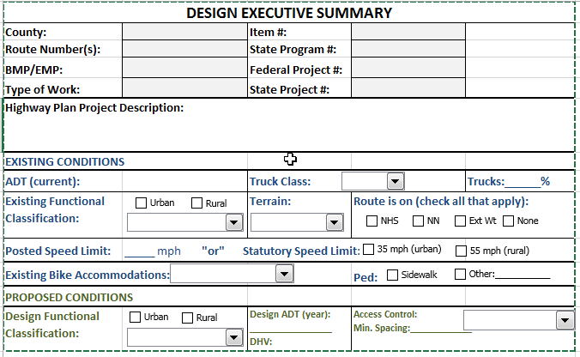
DES FORM AND CONTENTS

Slide 14
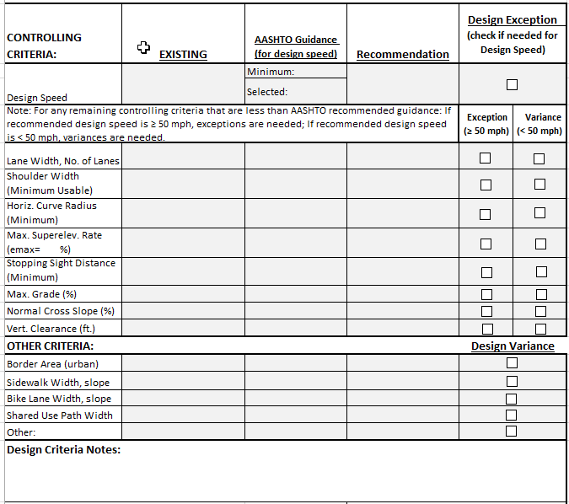
Design Executive Summary Form and Contents

Slide 15
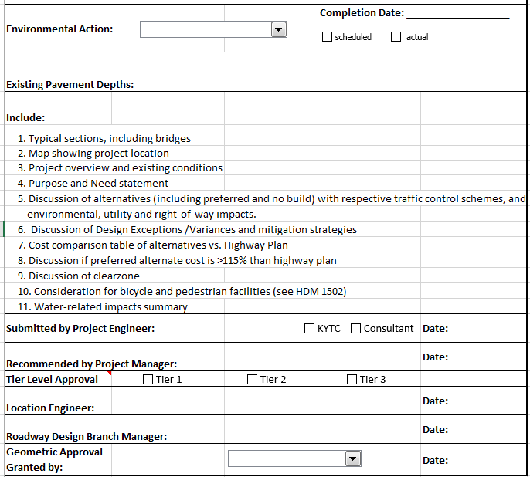
Design Executive Summary Form and Contents

Slide 16
HELPFUL WEBSITES
Purpose and Need Guidance Instructions:
http://transportation.ky.gov/Highway-Design/Documents/Purpose%20and%20Need%20Statement%20Guidance%20and%20Instructions.pdf
Highway Information View and Extract Interface (HIS):
http://datamart.business.transportation.ky.gov/EDSB_SOLUTIONS/HISEXTRACTS/
Highway Design DES Form:
http://transportation.ky.gov/Highway-Design/Pages/HighwayDesignForms.aspx
KYTC Webinar on DES:
http://transportation.ky.gov/Highway-Design/Pages/Software-and-Support.aspx
Design Memo for HDM Chapters 100&200: http://transportation.ky.gov/Highway-Design/Memos/01-15.pdf
KYTC DES Tracking File (intranet):
https://intranet.kytc.ky.gov/org/DPM/Pages/Status-Reports.aspx

Slide 17
QUESTIONS?

